Slide 1


Operational Excellence & Digital Transformation
Strategic Roadmap 2026
Prepared by: Bongani Khumalo
ICT Department
January 23, 2026

Slide 2




Executive Summary
From Functional Systems to Operational Excellence
Operational Efficiency
Eliminate manual reconciliation and reduce administrative overhead through automation.
Thusanang Funeral Services has successfully deployed a robust digital foundation. The TFS Digital System is now stable, functional and integral to daily operations.
Management Control
However, to realize the full return on this investment, the organization must now pivot from "system adoption" to "operational optimization." This requires addressing key gaps in communication discipline, resource allocation and process definition.
Gain real-time visibility into fleet, stock and staff allocation to prevent conflicts.
Service Excellence
Ensure every family receives dignified, error-free service through standardized workflows.
"The technology is ready. The next phase is about empowering our people to use it with precision and discipline."

Slide 3



Strategic Vision
Setting the Standard for Dignified Funeral Services
Dignity
Treating every individual and family with the utmost respect and honor.
Our vision is to be the premier provider of funeral services, recognized for our unwavering commitment to dignity, professionalism and community support.
Professionalism
Maintaining the highest standards of conduct, appearance and service delivery.
We strive to create an environment where every family feels supported and respected, ensuring that their loved ones are honored with the highest level of care.
Community
Being a trusted pillar of support and engagement within the communities we serve.
"To serve with dignity, compassion and excellence in every interaction."

Slide 4




System Architecture
Integrated Modules for End-to-End Management
Client Intake
Logistics & Fleet
Digital capture of client details, policy verification and service requirements at the first point of contact.
Automated scheduling of vehicles and drivers based on service location and timing requirements.
The TFS Digital Platform is architected to connect every aspect of the business. Data flows seamlessly from the initial client intake through to logistics planning and final financial reconciliation.
Financial Management
Reporting & Analytics
This integration eliminates data silos, ensuring that the finance team sees the same information as the operations team, reducing errors and improving speed.
Real-time invoicing, expense tracking and automated reconciliation of service costs.
Comprehensive dashboards providing visibility into operational performance and key metrics.

Slide 5






Advanced Technical Improvements Enabling Operational Control
Since November 2025, TFS Digital System updates expanded operational capabilities and improved reliability, directly addressing staff-reported pain points.
SendGrid Integration
Location Awareness
Operational Decoupling
Replaced SMTP with SendGrid API to ensure reliable delivery for critical emails.
Enhanced venue capture to support map-based routing and accurate travel times.
Moved key logic to Active Cases so operations can manage resources post-intake.
Tent Supplier Integration
Pricing Engine
Real-time GRV
Captures preferred vendors during consultation to streamline equipment orders.
Automatically calculates totals including extras and manual modifiers for accurate billing.
GRVs update inventory instantly on delivery, reflecting warehouse stock in real time.

Slide 6



Operational Challenge: Communication Discipline
No Audit Trail
Decisions made on chat apps are not recorded in the central system, making post-mortem analysis impossible.
The Risk of Informal Channels
Fragmented Information
Critical updates (e.g venue changes) may be seen by some staff but missed by others, leading to service errors.
A critical finding is the heavy reliance on informal communication channels, particularly WhatsApp groups, for operational decision-making.
While convenient, this practice bypasses the formal digital system, creating "shadow workflows" where critical information is lost, instructions are misinterpreted and accountability is impossible to enforce.
High Risk of Error
Manual transcription of instructions from chats to the system introduces human error.

Slide 7
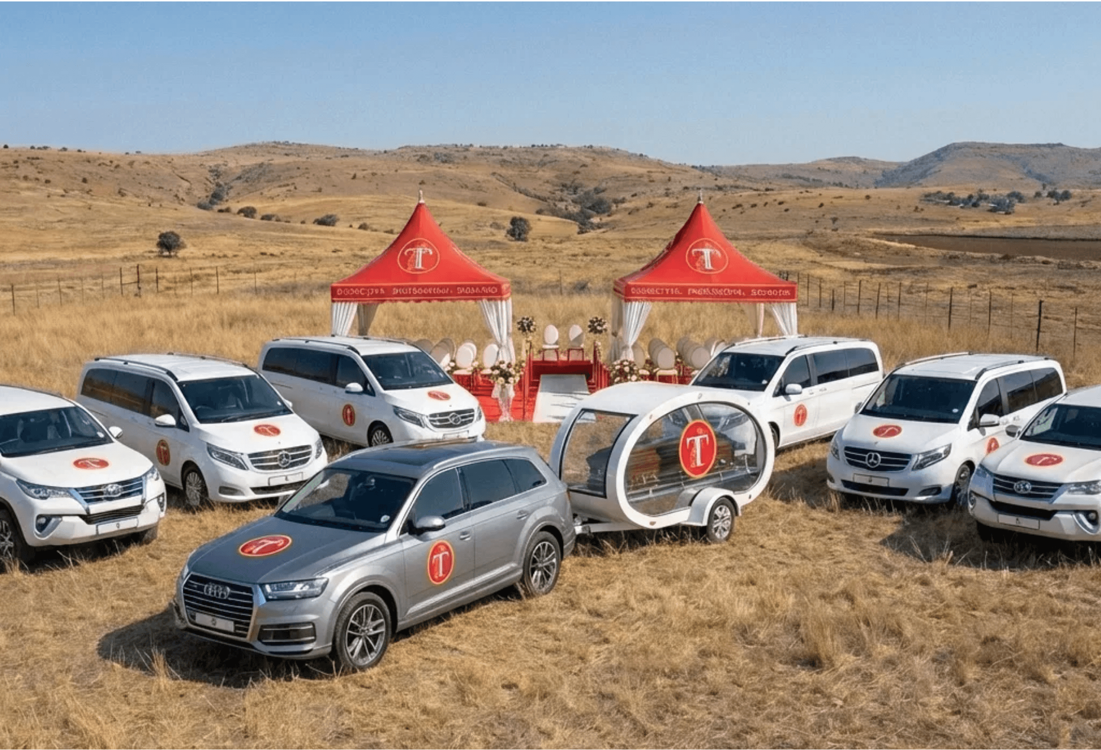

Operational Challenge: Resource Allocation
Optimizing Fleet and Staff Utilization
Effective resource management is hampered by reactive planning. Vehicles and staff are often assigned without a comprehensive view of the day's total demand, leading to conflicts.
The lack of a formalized "lock-down" period for schedules results in last-minute changes that disrupt operations and increase stress on the team.
Figure 2: Diverse fleet requiring precise coordination
Impact: Increased overtime costs and risk of service
delays.

Slide 8



Operational Challenge: Role Clarity
Office vs. Driver
Unclear distinction on site responsibilities (e.g., who manages the family vs. who manages the vehicle).
Defining Responsibilities for Accountability
Admin vs. Operations
Operational efficiency is hindered by blurred lines of responsibility. When roles are not clearly defined, tasks often fall through the cracks or are duplicated, leading to confusion.
Confusion over who is responsible for final verification of service details before dispatch.
A key area of concern is the overlap between administrative duties and operational execution, where staff members may not be clear on where their authority begins and ends.
Supervisor Authority
Inconsistent enforcement of protocols due to lack of clear supervisory mandates.

Slide 9
Challenge: Information Silos
1
Sales Personnel Meets Family
Sales & Operations Communication Gap
Takes requests (flowers, crucifix, logistic times )
⚠️ Doesn't document properly
↓
The Sales Personnel meets with families and takes their requests, but critical information is not being properly documented or communicated to Admin and the Driver/Undertaker team.
Admin Needs to Plan
2
Asks Salesperson what's needed
⚠️Incomplete capture
↓
❌ What Goes Wrong:
3
• Family requests special flowers → Driver shows up without them • Family needs 4 helpers → Only 2 helpers assigned • Family wants specific timing → Service runs late • Family is disappointed → Reputation damaged
3
Driver/Undertaker Arrives
Shows up unprepared for service
⚠️ No flowers, crucifix, Insufficient helpers
↓
4
Family is Disappointed
Root Cause: Incomplete capture and communication of family requests during the sales to operations handover.
Service doesn't meet expectations
⚠️ Reputation damage

Slide 10
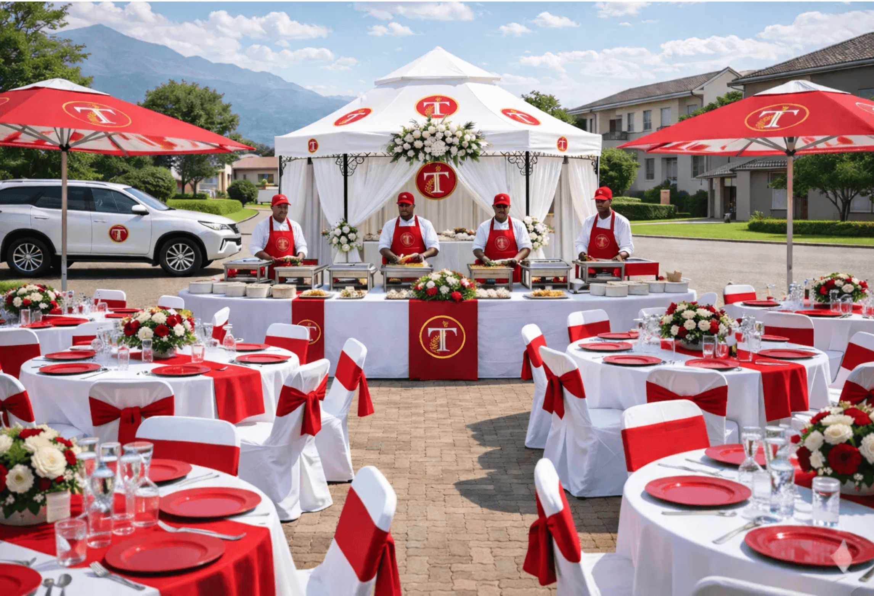
Operational Challenge: Private Funerals
Managing Complexity in Bespoke Services
Private funerals represent a high-value segment but introduce significant operational complexity. These services often require bespoke arrangements, from specialized catering to custom tent setups.
Current standard operating procedures are often strained by these unique requirements, leading to manual workarounds that increase the risk of service delivery errors.
Figure 3: High-touch service delivery for private funerals
"Standardization must not come at the cost of personalization. We need flexible frameworks."

Slide 11



Infrastructure Gap: Data Security
Shared Credentials
Multiple staff members using the same login details prevents individual accountability.
Protecting Sensitive Client Information
Unrestricted Access
A significant vulnerability exists in the current handling of system access. The practice of sharing passwords and using generic accounts compromises the integrity of the entire digital platform.
Lack of role-based permissions allows staff to access sensitive data irrelevant to their function.
Without individual user accountability, it is impossible to trace errors or unauthorized changes to their source, leaving the organization exposed to internal and external threats.
No Audit Logs
Inability to track who made specific changes to client files or financial records.

Slide 12



Infrastructure Gap: Internal Communication
No Daily Briefings
Teams lack a dedicated time to align on the day's priorities and potential challenges.
Moving Beyond Ad-Hoc Updates
Reactive Problem Solving
The absence of structured daily briefings means that teams often start their day misaligned. Information is shared reactively when problems arise, rather than proactively to prevent them.
Issues are addressed only after they escalate, rather than being mitigated in advance.
This "firefighting" mode of operation increases stress and reduces the team's ability to focus on delivering dignified service.
Information Asymmetry
Key details are often known by only a few individuals, creating bottlenecks.

Slide 13
Recommendations: Phase 1 (Immediate)
01
Daily Stand-up Meetings
Implement mandatory 15-minute morning briefings to align on the day's schedule and resource needs.
Stabilizing Operations and Enforcing Discipline
02
Formalize WhatsApp Protocol
Restrict WhatsApp to "FYI" notifications only. All decisions must be recorded in the TFS Digital System.
The immediate priority is to stabilize operations by enforcing discipline and establishing clear protocols. These "quick wins" will reduce error rates and prepare the team for deeper structural changes.
03
Define Role Boundaries
Publish clear job descriptions for staff to eliminate overlap.
04
Secure Access Control
Focus is on human behavior and process adherence rather than new technology.
Issue individual user accounts for all system users and enforce password policies.

Slide 14
Recommendations: Phase 2 (Strategic)
01
Private Funeral SOPs
Develop specialized workflows for private funerals that allow for customization within a structured framework.
Optimizing for Efficiency and Growth
02
Fleet Optimization
Implement predictive maintenance schedules and route optimization to reduce fuel costs and downtime.
With the foundation stabilized, the focus shifts to optimizing complex workflows and leveraging data for strategic decision-making.
03
Advanced Analytics
Deploy dashboards to track key performance indicators (KPIs) such as cost-per-service and staff utilization.
This phase targets high-value areas like private funerals and fleet management to maximize profitability and service quality.
04
Client Feedback Loop
Integrate automated post-service surveys to gather client feedback and drive continuous improvement.

Slide 15



Client Engagement Strategy
Digital Intake
Streamlined tablet-based intake process ensures accurate data capture and immediate policy verification.
Building Trust Through Every Interaction
Transparent Pricing
Our relationship with clients extends beyond the funeral service itself. By leveraging digital tools, we can enhance the client experience from the first point of contact through to post-service support.
Clear, itemized digital quotes prevent billing disputes and build confidence in our integrity.
Post-Service Care
Transparency and ease of access are key to building long-term trust and community loyalty.
Automated follow ups to check on the family's well-being and offer grief counseling resources.

Slide 16

The New Daily Operational Rhythm
PROPOSE A SPECIFIC TIME
Morning Stand-up
All-hands briefing to review the day's schedule, assign vehicles and highlight critical tasks.
PROPOSE A SPECIFIC CUT OFF TIME
Structured Routines for Consistent Delivery
Admin Lock-down
Cut-off for new service requests for the following day to allow for logistics planning.
Establishin a predictable daily rhythm is essential for reducing chaos. By standardizing key touchpoints throughout the day, we ensure that every team member is aligned and that potential issues are caught early.
DURING A DAY
Operations Review
Mid-day check-in to address any emerging issues and confirm readiness for afternoon tasks.
PROPOSE A SPECIFIC TIME
This structure transforms operations from reactive "firefighting" to proactive management.
Next Day Prep
Final verification of tomorrow's roster, vehicle checks and staff notifications.

Slide 17

Implementation Roadmap 2026
A Phased Approach to Transformation
Q1
Q2
Q3
Q4
Stabilization
Optimization
Expansion
Innovation
•
Implement Daily Stand-ups
•
Private Funeral SOPs
•
New Branch Rollout Plan
•
Advanced Analytics Dashboard
•
Enforce WhatsApp Protocol
•
Fleet Route Optimization
•
Marketing Campaign Launch
•
Mobile App for Clients
•
Define Role Descriptions
•
Inventory Control System
•
Client Portal Beta
•
Green Funeral Services
•
Secure System Access
•
Staff Training Program
•
Strategic Partnerships
•
Annual Performance Review

Slide 18



Measuring Success
Key Performance Indicators (KPIs)
Operational
Financial
Service Quality
Service Error Rate
< 1%
Cost per Service
-10%
Client Satisfaction
4.8/5
On-Time Departure
98%
Revenue per Client
+15%
Referral Rate
+25%
Fleet Availability
95%
Overtime Costs
-20%
Complaint Resolution
< 24h

Slide 19



Change Management Strategy
Clear Communication
Regular town halls to explain the "why" behind changes and address concerns openly.
Guiding the Team Through Transformation
Comprehensive Training
The success of this transformation depends entirely on staff adoption. We are asking the team to move from familiar, informal habits to disciplined, digital-first workflows.
Hands-on workshops and digital guides to ensure everyone is comfortable with the new tools.
This cultural shift requires empathy, clear communication and consistent support to ensure that every team member feels empowered rather than policed.
Change Champions
Identify and empower influential staff members to lead by example and support their peers.

Slide 20

Conclusion
A Future Built on Excellence
By addressing current operational gaps and fully embracing digital discipline, Thusanang Funeral Services will not only improve internal efficiency but also elevate the standard of care for every family served.
"Operational Excellence is the highest form of respect we can pay to the families who trust us."

Slide 21

Thank You
Discussion & Next Steps
Thusanang Funeral Services
Operational Excellence Strategy 2026

